Slide 1
Introduction to Image Segmentation

Slide 2
What we will be covering in this module?

Slide 3
What we will be covering in this module?
Introduction to Image Segmentation

Slide 4
What we will be covering in this module?
Introduction to Image Segmentation
How to solve Image Segmentation problems?

Slide 5
What we will be covering in this module?
Introduction to Image Segmentation
How to solve Image Segmentation problems?
Approaches for Image Segmentation
Use Traditional Methods
Leverage Deep Learning

Slide 6
What we will be covering in this module?
Introduction to Image Segmentation
How to solve Image Segmentation problems?
Approaches for Image Segmentation
Use Traditional Methods
Leverage Deep Learning
Understanding Deep Learning Architectures for Image Segmentation

Slide 7
What we will be covering in this module?
Introduction to Image Segmentation
How to solve Image Segmentation problems?
Approaches for Image Segmentation
Use Traditional Methods
Leverage Deep Learning
Understanding Deep Learning Architectures for Image Segmentation
Project on Lane Segmentation for Self Driving Cars

Slide 8
What we will be covering in this module?
Introduction to Image Segmentation
How to solve Image Segmentation problems?
Approaches for Image Segmentation
Use Traditional Methods
Leverage Deep Learning
Understanding Deep Learning Architectures for Image Segmentation
Project on Lane Segmentation for Self Driving Cars
What’s Next?

Slide 9
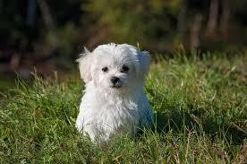
Recap on problems in Computer Vision
Q. What is the object present in the image?

Slide 10
Recap on problems in Computer Vision
Q. What is the object present in the image?
There is a dog!

Slide 11
Recap on problems in Computer Vision
Q. What is the object present in the image?
There is a dog!
Formulate this as image classiﬁcation problem

Slide 12
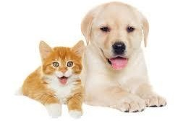
Recap on problems in Computer Vision
Q. What is the object present in the image?

Slide 13
Recap on problems in Computer Vision
Q. What are the objects present in the image?

Slide 14
Recap on problems in Computer Vision
Q. What are the objects present in the image?
There is a dog and a cat!

Slide 15
Recap on problems in Computer Vision
Q. What are the objects present in the image?
There is a dog and a cat!
Formulate this as multi-class image classiﬁcation problem

Slide 16
Recap on problems in Computer Vision
Q. What are the objects present in the image? Where are they?

Slide 17
Recap on problems in Computer Vision
Dog
Q. What are the objects present in the image? Where are they?
Cat
There is a dog and a cat!
The dog → blue box The cat → red box

Slide 18
Recap on problems in Computer Vision
Dog
Q. What are the objects present in the image? Where are they?
Cat
There is a dog and a cat!
The dog → blue box The cat → red box
Formulate this as object detection problem

Slide 19
What is Image Segmentation?
Q. What are the objects present in the image? Where are they exactly?

Slide 20
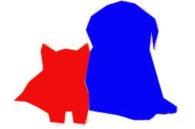
What is Image Segmentation?
Q. What are the objects present in the image? Where are they exactly?
There is a dog and a cat!
The dog → coloured as blue
The cat → coloured as red

Slide 21

What is Image Segmentation?
Q. What are the objects present in the image? Where are they exactly?
There is a dog and a cat!
The dog → coloured as blue The cat → coloured as red
Formulate this as image segmentation problem

Slide 22
What is Image Segmentation?
Image Segmentation is the task of partitioning an image into multiple segments

Slide 23
Applications of Image Segmentation

Slide 24
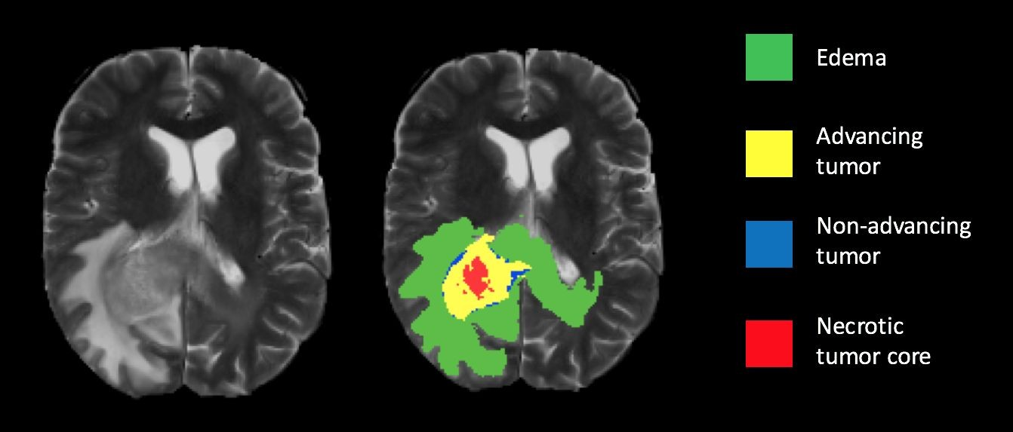
Applications of Image Segmentation
Medical Imaging
Cancer Cell Segmentation
Brain Lesion Segmentation

Slide 25
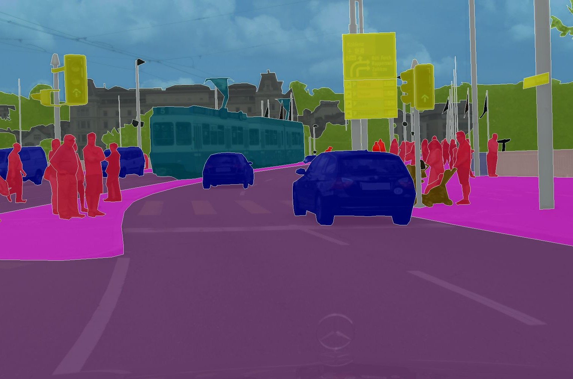
Applications of Image Segmentation
● Medical Imaging
○ Cancer Cell Segmentation
○ Brain Lesion Segmentation
Self Driving Cars
Lane Segmentation
Pedestrian Identiﬁcation
Source: Marius Cordts et al: “The Cityscapes Dataset for Semantic Urban Scene Understanding”, 2016

Slide 26
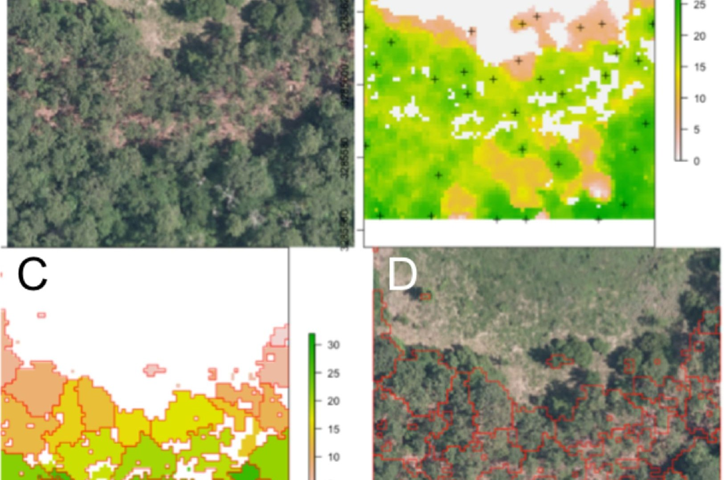
Applications of Image Segmentation
● Medical Imaging
○ Cancer Cell Segmentation
○ Brain Lesion Segmentation
● Self Driving Cars
○ Lane Segmentation
○ Pedestrian Identiﬁcation
Satellite imaging / Remote sensing
Forest Area Segmentation
Locating water bodies (lakes, rivers, oceans)
Source: McMahon CA. 2019. Remote sensing pipeline for tree segmentation and classiﬁcation in a mixed softwood and hardwood system

Slide 27
Types of Image Segmentation Problems

Slide 28
Types of Image Segmentation Problems
Semantic Segmentation

Slide 29
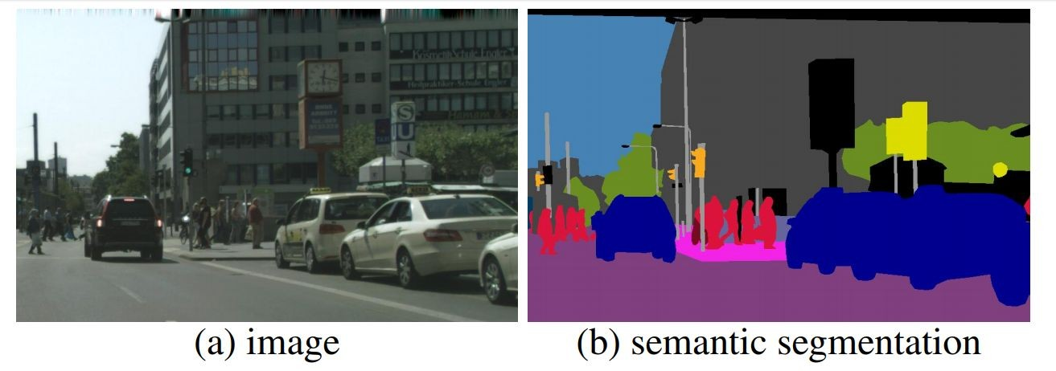
Types of Image Segmentation Problems

Slide 30
Types of Image Segmentation Problems
Semantic Segmentation -
Describes the process of associating each pixel of an image with a class label
Instance Segmentation

Slide 31
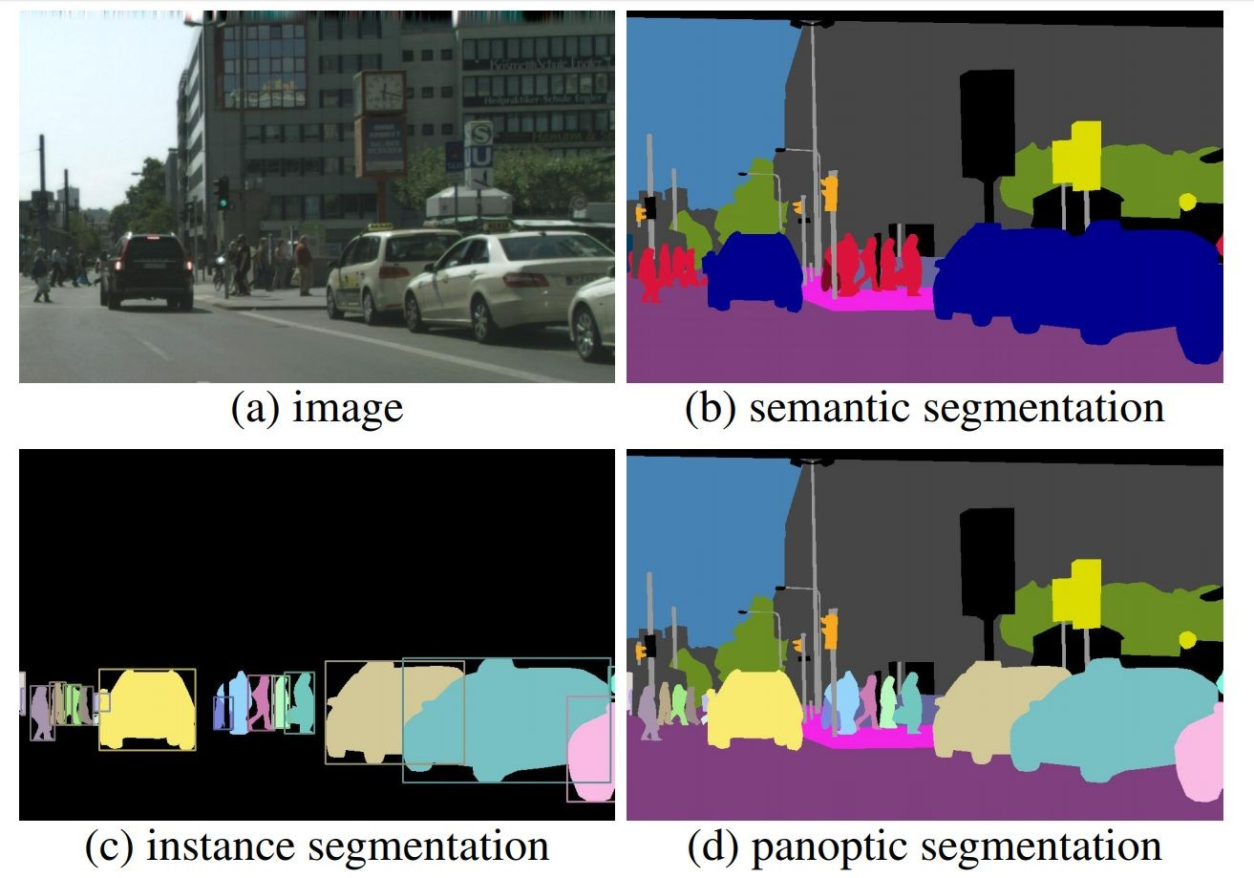
Types of Image Segmentation Problems

Slide 32
Types of Image Segmentation Problems
Semantic Segmentation -
Describes the process of associating each pixel of an image with a class label
Instance Segmentation -
Instance segmentation masks each instance of an object contained in an image independently.
We only focus on the objects of importance ﬁrst, and then identify instances of the object

Slide 33
Types of Image Segmentation Problems
Semantic Segmentation -
Describes the process of associating each pixel of an image with a class label
Instance Segmentation -
Instance segmentation masks each instance of an object contained in an image independently.
We only focus on the objects of importance ﬁrst, and then identify instances of the object
Panoptic Segmentation –
combines these tasks to give us a very detailed analysis of an image. It colors the image by category, like in semantic segmentation, but it also distinguishes between different objects of the same type, like in instance segmentation.

Slide 34
Types of Image Segmentation Problems

Slide 35
What we will be covering in this module?
Introduction to Image Segmentation
How to solve Image Segmentation problems?
Approaches for Image Segmentation
Use Traditional Methods
Leverage Deep Learning
Understanding Deep Learning Architectures for Image Segmentation
Project on Lane Segmentation for Self Driving Cars
What’s Next?

Slide 36
What is Image Segmentation?
Image Segmentation is the task of partitioning an image into multiple segments

Slide 37
Applications of Image Segmentation

Slide 38
Applications of Image Segmentation
Medical Imaging
Cancer Cell Segmentation
Brain Lesion Segmentation
Self Driving Cars
Lane Segmentation
Pedestrian Identiﬁcation
Satellite imaging / Remote sensing
Forest Area Segmentation
Locating water bodies (lakes, rivers, oceans)

Slide 39
Types of Image Segmentation Problems

Slide 40
Types of Image Segmentation Problems
Semantic Segmentation -
Describes the process of associating each pixel of an image with a class label
Instance Segmentation -
Instance segmentation masks each instance of an object contained in an image independently.
We only focus on the objects of importance ﬁrst, and then identify instances of the object
Panoptic Segmentation -
Combination of semantic and instance segmentation

Slide 41
What we will be covering in this module?
Introduction to Image Segmentation
How to solve Image Segmentation problems?
Approaches for Image Segmentation
Use Traditional Methods
Leverage Deep Learning
Understanding Deep Learning Architectures for Image Segmentation
Project on Lane Segmentation for Self Driving Cars
What’s Next?

Slide 42
How to solve an Image Segmentation problem?

Slide 43
What we will be covering in this module?
Introduction is Image Segmentation
How to solve Image Segmentation problems?
Approaches for Image Segmentation
Use Traditional Methods
Leverage Deep Learning
Understanding Deep Learning Architectures for Image Segmentation
Project on Lane Segmentation for Self Driving Cars
What’s Next?

Slide 44
Understanding Blood Cell Segmentation

Slide 45
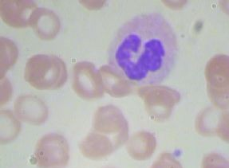
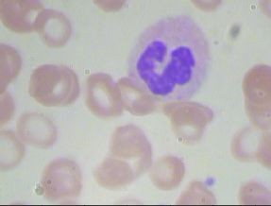
Recap - Blood Cell Detection
Problem Statement: Detect the WBCs in the Images of Blood Cells
Sample Image
WBC

Slide 46
Understanding Blood Cell Segmentation
Problem Statement: Segmenting WBCs in the Images of Blood Cells
Sample Image
WBC

Slide 47
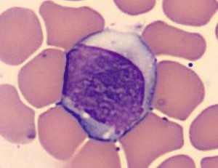
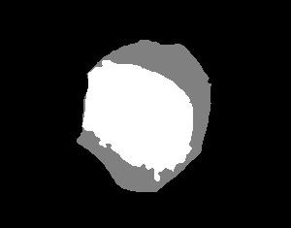
Exploring Blood Cell Segmentation Dataset
Problem Statement: Segmenting WBCs in the Images of Blood Cells
Sample Image
WBC

Slide 48
Exploring Blood Cell Segmentation Dataset
Problem Statement: Segmenting WBCs in the Images of Blood Cells
Sample Image
WBC

Slide 49

Exploring Blood Cell Segmentation Dataset
Problem Statement: Segmenting WBCs in the Images of Blood Cells
Binary Semantic Segmentation!
Sample Image
WBC

Slide 50
Approach to solve Blood Cell Segmentation

Slide 51
What we will be covering in this module?
Introduction is Image Segmentation
How to solve Image Segmentation problems?
Approaches for Image Segmentation
Use Traditional Methods
Leverage Deep Learning
Understanding Deep Learning Architectures for Image Segmentation
Project on Lane Segmentation for Self Driving Cars
What’s Next?

Slide 52
Thank you

Slide 53
Approach 1 - Simple methods for Image Segmentation

Slide 54
What we will be covering in this module?
Introduction is Image Segmentation
How to solve Image Segmentation problems?
Approaches for Image Segmentation
Use Traditional Methods
Leverage Deep Learning
Understanding Deep Learning Architectures for Image Segmentation
Project on Lane Segmentation for Self Driving Cars
What’s Next?

Slide 55
Approach to solve Blood Cell Segmentation

Slide 56
Color as a feature for classification

Slide 57
Color as a feature for classification

Slide 58
Color as a feature for classification

Slide 59
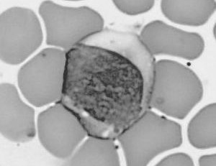
Color as a feature for classification

Slide 60

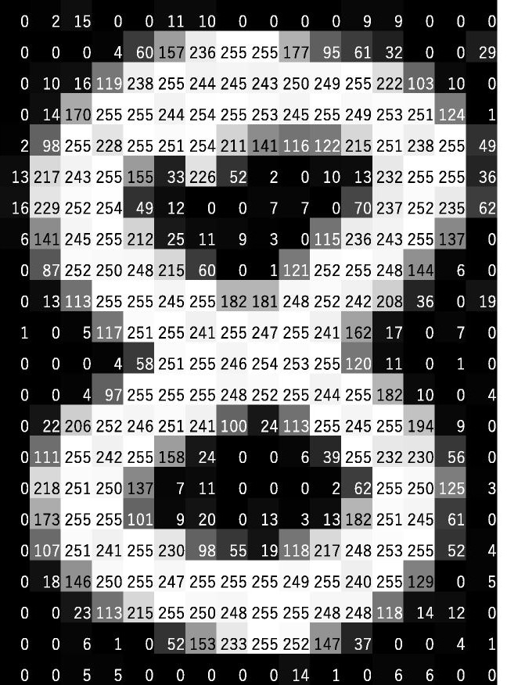
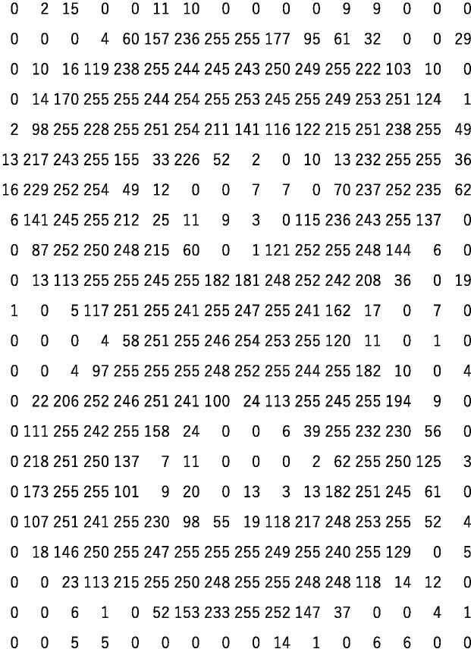
Concept of Thresholding

Slide 61
Image Segmentation through Thresholding

Slide 62
Image Segmentation through Thresholding
grayscale

Slide 63
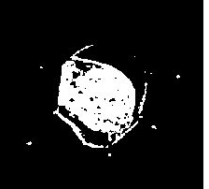
Image Segmentation through Thresholding
grayscale
threshold

Slide 64
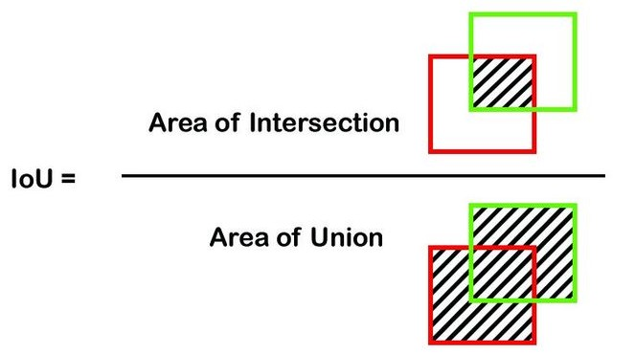
Evaluation metric for Image Segmentation
> threshold

Slide 65
Steps for Image Segmentation through Thresholding
1. Data Loading and Preprocessing

Slide 66
Steps for Image Segmentation through Thresholding
Data Loading and Preprocessing
Load the Data

Slide 67
Steps for Image Segmentation through Thresholding
Data Loading and Preprocessing
Load the Data
Data Exploration

Slide 68
Steps for Image Segmentation through Thresholding
Data Loading and Preprocessing
Load the Data
Data Exploration
Data Preprocessing

Slide 69
Steps for Image Segmentation through Thresholding
Data Loading and Preprocessing
Load the Data
Data Exploration
Data Preprocessing
Image Segmentation through Thresholding

Slide 70
Steps for Image Segmentation through Thresholding
Data Loading and Preprocessing
Load the Data
Data Exploration
Data Preprocessing
Image Segmentation through Thresholding
Convert image to grayscale

Slide 71
Steps for Image Segmentation through Thresholding
Data Loading and Preprocessing
Load the Data
Data Exploration
Data Preprocessing
Image Segmentation through Thresholding
Convert image to grayscale
Apply the right threshold

Slide 72
Steps for Image Segmentation through Thresholding
Data Loading and Preprocessing
Load the Data
Data Exploration
Data Preprocessing
Image Segmentation through Thresholding
Convert image to grayscale
Apply the right threshold
Calculate IoU score

Slide 73
Code Walkthrough of Thresholding

Slide 74
Image Segmentation through Thresholding
Pros:
Simple Approach - Easy to understand

Slide 75
Image Segmentation through Thresholding
Pros:
Simple Approach - Easy to understand
Cons:
Involves hard coding threshold values

Slide 76
Image Segmentation through Thresholding
Pros:
Simple Approach - Easy to understand
Cons:
Involves hard coding threshold values
Different images can have different thresholds

Slide 77
Image Segmentation through Thresholding
Pros:
Simple Approach - Easy to understand
Cons:
Involves hard coding threshold values
Different images can have different thresholds
Different objects can have same color

Slide 78
Approach to solve Blood Cell Segmentation

Slide 79
Thank you

Slide 80
Approach 1 - Simple methods for Image Segmentation

Slide 81
Rethinking Image Segmentation Problem

Slide 82
Image Segmentation through Clustering

Slide 83
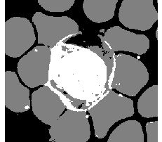
Image Segmentation through Clustering
clustering

Slide 84
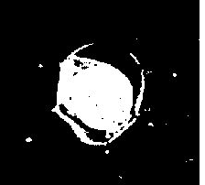
Image Segmentation through Clustering
clustering
filtering

Slide 85
Steps for Image Segmentation through Clustering
1. Data Loading and Preprocessing

Slide 86
Steps for Image Segmentation through Clustering
Data Loading and Preprocessing
Load the Data

Slide 87
Steps for Image Segmentation through Clustering
Data Loading and Preprocessing
Load the Data
Data Exploration

Slide 88
Steps for Image Segmentation through Clustering
Data Loading and Preprocessing
Load the Data
Data Exploration
Data Cleaning

Slide 89
Steps for Image Segmentation through Clustering
Data Loading and Preprocessing
Load the Data
Data Exploration
Data Cleaning
Image Segmentation through Clustering

Slide 90
Steps for Image Segmentation through Clustering
Data Loading and Preprocessing
Load the Data
Data Exploration
Data Cleaning
Image Segmentation through Clustering
Apply k-means clustering on the image

Slide 91
Steps for Image Segmentation through Clustering
Data Loading and Preprocessing
Load the Data
Data Exploration
Data Cleaning
Image Segmentation through Clustering
Apply k-means clustering on the image
Filter the appropriate category

Slide 92
Steps for Image Segmentation through Clustering
Data Loading and Preprocessing
Load the Data
Data Exploration
Data Cleaning
Image Segmentation through Clustering
Apply k-means clustering on the image
Filter the appropriate category
Calculate IoU score

Slide 93
Code Walkthrough of Clustering

Slide 94
Image Segmentation through Clustering
Pros:
Simple Approach

Slide 95
Image Segmentation through Clustering
Pros:
Simple Approach
Performs better than thresholding

Slide 96
Image Segmentation through Clustering
Pros:
Simple Approach
Performs better than thresholding
Can be applied for multiple images

Slide 97
Image Segmentation through Clustering
Pros:
Simple Approach
Performs better than thresholding
Can be applied for multiple images
Cons:
Manual filtering for appropriate cluster

Slide 98
Image Segmentation through Clustering
Pros:
Simple Approach
Performs better than thresholding
Can be applied for multiple images
Cons:
Manual filtering for appropriate cluster
Different categories can have same color

Slide 99
Image Segmentation through Clustering
Pros:
Simple Approach
Performs better than thresholding
Can be applied for multiple images
Cons:
Manual filtering for appropriate cluster
Different categories can have same color
Doesn’t adjust well for large datasets

Slide 100
Better Approach to solve Blood Cell Segmentation?

Slide 101
Better Approach to solve Blood Cell Segmentation?
Deep Learning

Slide 102
Thank you

Slide 103
Approach 2 - Naive Deep Learning based Approach

Slide 104
What we will be covering in this module?
Introduction is Image Segmentation
How to solve Image Segmentation problems?
Approaches for Image Segmentation
Use Traditional Methods
Leverage Deep Learning
Understanding Deep Learning Architectures for Image Segmentation
Project on Lane Segmentation for Self Driving Cars
What’s Next?

Slide 105
Approach to solve Blood Cell Segmentation
Deep Learning

Slide 106
Recap - Approach to solve Blood Cell Detection
No | Yes
No | No
Step 1: Divide image into patches
Step 2: Classify each patch
Step 3: Return Patch coordinates as bounding box

Slide 107

Naive Approach for Image Segmentation

Slide 108
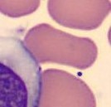
Naive Approach for Image Segmentation

Slide 109

Naive Approach for Image Segmentation
Background

Slide 110

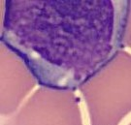
Naive Approach for Image Segmentation
Background

Slide 111

Naive Approach for Image Segmentation
Background
WBC

Slide 112


Naive Approach for Image Segmentation
Step 1: Divide image into patches
for every pixel

Slide 113
Naive Approach for Image Segmentation
Step 1: Divide image into patches
for every pixel
Step 2: Classify each patch

Slide 114
Naive Approach for Image Segmentation
Step 1: Divide image into patches
for every pixel
Step 2: Classify each patch
Step 3: Return output as a heatmap of predictions

Slide 115
Naive Approach for Image Segmentation
Step 1: Divide image into patches
for every pixel
Step 2: Classify each patch
Step 3: Return output as a heatmap of predictions
Step 4: Threshold heatmap

Slide 116
Naive Approach for Image Segmentation
Pros:
Not just based on color, extracts features in an intelligent way

Slide 117
Naive Approach for Image Segmentation
Pros:
Not just based on color, extracts features in an intelligent way
May performs better than heuristics based approaches

Slide 118
Naive Approach for Image Segmentation
Pros:
Not just based on color, extracts features in an intelligent way
May performs better than heuristics based approaches
Cons:
Too computationally expensive to even be feasible

Slide 119
Improvements in Naive Approach
Improvement:
A single CNN which works on input image and gives an output heatmap

Slide 120
Recap - CNN for Image Classification
Input Layer
Convolution Layer
Hidden Layer
Output Layer
Feature Extractor

Slide 121
CNN for Image Segmentation
Convolution Layer
Hidden Layer
Feature Extractor

Slide 122
Modified CNN for Image Segmentation
Convolution Layer
Conv+Sigmoid
Feature Extractor

Slide 123
Modified CNN for Image Segmentation
Convolution Layer
Conv+Sigmoid
Feature Extractor
Binary
Cross-Entropy Loss

Slide 124
Improvements in Naive Approach
Improvement:
A single CNN which works on input image and gives an output heatmap
Pros:
Computationally less expensive

Slide 125
Improvements in Naive Approach
Improvement:
A single CNN which works on input image and gives an output heatmap
Pros:
Computationally less expensive
Cons:
Output not of the same size

Slide 126
Improvements in Naive Approach
Improvements:
A single CNN which works on input image and gives an output heatmap
No pooling layer
Pros:
Computationally less expensive

Slide 127
Improvements in Naive Approach
Improvements:
A single CNN which works on input image and gives an output heatmap
No pooling layer
Pros:
Computationally less expensive
Cons:
Output not of same size (due to undefined padding,stride in conv layer)

Slide 128
Improvements in Naive Approach
Improvements:
A single CNN which works on input image and gives an output heatmap
No pooling layer, conv layer with stride as 1

Slide 129
Improvements in Naive Approach
Improvements:
A single CNN which works on input image and gives an output heatmap
No pooling layer, conv layer with stride as 1 (pad accordingly)

Slide 130
Improvements in Naive Approach
Improvements:
A single CNN which works on input image and gives an output heatmap
No pooling layer, conv layer with stride as 1 (pad accordingly)
Pros:
Computationally less expensive

Slide 131
Improvements in Naive Approach
Improvements:
A single CNN which works on input image and gives an output heatmap
No pooling layer, conv layer with stride as 1 (pad accordingly)
Pros:
Computationally less expensive
Output of same size

Slide 132
Improvements in Naive Approach
Improvements:
A single CNN which works on input image and gives an output heatmap
No pooling layer, conv layer with stride as 1 (pad accordingly)
Pros:
Computationally less expensive
Output of same size
Cons:
Options for DL architecture is limited

Slide 133
Steps for Image Segmentation using CNN based model
1. Data Loading and Preprocessing

Slide 134
Steps for Image Segmentation using CNN based model
Data Loading and Preprocessing
Load the Data

Slide 135
Steps for Image Segmentation using CNN based model
Data Loading and Preprocessing
Load the Data
Define custom dataset and dataloader

Slide 136
Steps for Image Segmentation using CNN based model
Data Loading and Preprocessing
Load the Data
Define custom dataset and dataloader
Data Exploration

Slide 137
Steps for Image Segmentation using CNN based model
Data Loading and Preprocessing
Load the Data
Define custom dataset and dataloader
Data Exploration
Image Segmentation through CNN based model

Slide 138
Steps for Image Segmentation using CNN based model
Data Loading and Preprocessing
Load the Data
Define custom dataset and dataloader
Data Exploration
Image Segmentation through CNN based model
Define model architecture

Slide 139
Steps for Image Segmentation using CNN based model
Data Loading and Preprocessing
Load the Data
Define custom dataset and dataloader
Data Exploration
Image Segmentation through CNN based model
Define model architecture
Train the model

Slide 140
Steps for Image Segmentation using CNN based model
Data Loading and Preprocessing
Load the Data
Define custom dataset and dataloader
Data Exploration
Image Segmentation through CNN based model
Define model architecture
Train the model
Calculate IoU score

Slide 141
Thank you

Slide 142
Code Walkthrough of Improved Naive Approach

Slide 143
Summary of Naive DL based Approach
Pros:
Single CNN network (almost end to end)

Slide 144
Summary of Naive DL based Approach
Pros:
Single CNN network (almost end to end)
Performs better than heuristics based approaches

Slide 145
Summary of Naive DL based Approach
Pros:
Single CNN network (almost end to end)
Performs better than heuristics based approaches
Generalizes well for unseen data

Slide 146
Summary of Naive DL based Approach
Pros:
Single CNN network (almost end to end)
Performs better than heuristics based approaches
Generalizes well for unseen data
Cons:
Feasible but still computationally expensive (as no pooling layer is used)

Slide 147
Summary of Naive DL based Approach
Pros:
Single CNN network (almost end to end)
Performs better than heuristics based approaches
Generalizes well for unseen data
Cons:
Feasible but still computationally expensive (as no pooling layer is used)
Options for DL architecture is limited

Slide 148
Summary of Naive DL based Approach
Pros:
Single CNN network (almost end to end)
Performs better than heuristics based approaches
Generalizes well for unseen data
Cons:
Feasible but still computationally expensive (as no pooling layer is used)
Options for DL architecture is limited
Simplistic DL model, doesn’t take ideas from complex networks

Slide 149
Approach to solve Blood Cell Segmentation
Advanced Deep Learning

Slide 150
Thank you

Slide 151
Approach 3 - End to End Deep Learning Approach

Slide 152
What we will be covering in this module?
Introduction is Image Segmentation
How to solve Image Segmentation problems?
Approaches for Image Segmentation
Use Traditional Methods
Leverage Deep Learning
Understanding Deep Learning Architectures for Image Segmentation
Project on Lane Segmentation for Self Driving Cars
What’s Next?

Slide 153
Approach to solve Blood Cell Segmentation
Advanced Deep Learning

Slide 154
Summary of Naive DL based Approach
Cons:
Feasible but still computationally expensive
Options for DL architecture is limited
Simplistic DL model, doesn’t take ideas from complex networks

Slide 155
What do we need?
Feasible but still computationally expensive (as no pooling layer is used)

Slide 156
What do we need?
Feasible but still computationally expensive (as no pooling layer is used)
Inverse Operation for Pooling

Slide 157
Recap - Max Pooling
5 | 1 | 11 | 3
2 | 3 | 10 | 3
0 | 4 | 9 | 15
7 | 10 | 8 | 8
4 x 4
Pool size = 2 x 2

Slide 158
Recap - Max Pooling
5 | 1 | 11 | 3
2 | 3 | 10 | 3
0 | 4 | 9 | 15
7 | 10 | 8 | 8
5
4 x 4
Pool size = 2 x 2

Slide 159
Recap - Max Pooling
5 | 1 | 11 | 3
2 | 3 | 10 | 3
0 | 4 | 9 | 15
7 | 10 | 8 | 8
5
11
4 x 4
Pool size = 2 x 2

Slide 160
Recap - Max Pooling
5 | 1 | 11 | 3
2 | 3 | 10 | 3
0 | 4 | 9 | 15
7 | 10 | 8 | 8
5
11
10
4 x 4
Pool size = 2 x 2

Slide 161
Recap - Max Pooling
5 | 1 | 11 | 3
2 | 3 | 10 | 3
0 | 4 | 9 | 15
7 | 10 | 8 | 8
5 | 11
10 | 15
4 x 4
Pool size = 2 x 2
2 x 2

Slide 162
Method 1: Simple idea for UnPooling
5 | 11
10 | 15
2 x 2
Filter size = 2 x 2

Slide 163
Method 1: Simple idea for UnPooling
5 | 0
0 | 0
5 | 11
10 | 15
2 x 2
Filter size = 2 x 2

Slide 164
Method 1: Simple idea for UnPooling
5 | 0 | 11 | 0
0 | 0 | 0 | 0
5 | 11
10 | 15
2 x 2
Filter size = 2 x 2

Slide 165
Method 1: Simple idea for UnPooling
5 | 0 | 11 | 0
0 | 0 | 0 | 0
10 | 0
0 | 0
5 | 11
10 | 15
2 x 2
Filter size = 2 x 2

Slide 166
Method 1: Simple idea for UnPooling
5 | 0 | 11 | 0
0 | 0 | 0 | 0
10 | 0 | 15 | 0
0 | 0 | 0 | 0
5 | 11
10 | 15
2 x 2
Filter size = 2 x 2
4 x 4

Slide 167
Method 2: Bilinear Interpolation Operation
5 | 11
10 | 15
2 x 2
Filter size = 2 x 2

Slide 168
Method 2: Bilinear Interpolation Operation
5 |  |  | 11
10 |  |  | 15
5 | 11
10 | 15
2 x 2
Filter size = 2 x 2
4 x 4

Slide 169
Method 2: Bilinear Interpolation Operation
5 |  |  | 11
6
9
10 |  |  | 15
5 | 11
10 | 15
2 x 2
Filter size = 2 x 2
4 x 4

Slide 170
Method 2: Bilinear Interpolation Operation
5 | 6 | 9 | 11
6
9
10 |  |  | 15
5 | 11
10 | 15
2 x 2
Filter size = 2 x 2
4 x 4

Slide 171
Method 2: Bilinear Interpolation Operation
5 | 6 | 9 | 11
6 | 8
9 |  | 12
10 |  |  | 15
5 | 11
10 | 15
2 x 2
Filter size = 2 x 2
4 x 4

Slide 172
Method 2: Bilinear Interpolation Operation
5 | 6 | 9 | 11
6 | 8 | 10 | 12
9 | 10 | 12 | 14
10 | 11 | 14 | 15
5 | 11
10 | 15
2 x 2
Filter size = 2 x 2
4 x 4

Slide 173
Method 3: Max Unpooling Operation

Slide 174
Method 3: Max Pooling Indices
5 | 1 | 11 | 3
2 | 3 | 10 | 3
0 | 4 | 9 | 15
7 | 10 | 8 | 8
5 | 11
10 | 15
4 x 4
Pool size = 2 x 2
2 x 2

Slide 175
Method 3: Max Unpooling Operation
5 | 0
0 | 0
5 | 11
10 | 15
2 x 2
Filter size = 2 x 2

Slide 176
Method 3: Max Unpooling Operation
5 | 0 | 11 | 0
0 | 0 | 0 | 0
5 | 11
10 | 15
2 x 2
Filter size = 2 x 2

Slide 177
Method 3: Max Unpooling Operation
5 | 0 | 11 | 0
0 | 0 | 0 | 0
0 | 0
0 | 10
5 | 11
10 | 15
2 x 2
Filter size = 2 x 2

Slide 178
Method 3: Max Unpooling Operation
5 | 0 | 11 | 0
0 | 0 | 0 | 0
0 | 0 | 0 | 15
0 | 10 | 0 | 0
5 | 11
10 | 15
2 x 2
Filter size = 2 x 2
4 x 4

Slide 179
Method 3: Max Unpooling Operation
5 | 1 | 11 | 3
2 | 3 | 10 | 3
0 | 4 | 9 | 15
7 | 10 | 8 | 8
5 | 0 | 11 | 0
0 | 0 | 0 | 0
0 | 0 | 0 | 15
0 | 10 | 0 | 0
5 | 11
10 | 15
Pool size = 2 x 2
Filter size = 2 x 2
4 x 4
2 x 2
4 x 4

Slide 180
Method 3: Max Unpooling Operation
Max UnPooling is also called
In Network Upsampling
5 | 1 | 11 | 3
2 | 3 | 10 | 3
0 | 4 | 9 | 15
7 | 10 | 8 | 8
5 | 0 | 11 | 0
0 | 0 | 0 | 0
0 | 0 | 0 | 15
0 | 10 | 0 | 0
5 | 11
10 | 15
Pool size = 2 x 2
Filter size = 2 x 2
4 x 4
2 x 2
4 x 4

Slide 181
What do we need?
Feasible but still computationally expensive
Inverse Operation for Pooling (Bilinear Interpolation, Max Unpooling)

Slide 182
What do we need?
Feasible but still computationally expensive
Inverse Operation for Pooling (Bilinear Interpolation, Max Unpooling)
Options for DL architecture is limited

Slide 183
What do we need?
Feasible but still computationally expensive
Inverse Operation for Pooling (Bilinear Interpolation, Max Unpooling)
Options for DL architecture is limited
A Convolution Operation which increases size of output

Slide 184
Recap - Convolution Operation
Filter size = 3 x 3
Stride = 2
Padding = 1
5 x 5

Slide 185
Recap - Convolution Operation
Filter size = 3 x 3
Stride = 2
Padding = 1
5 x 5

Slide 186
Recap - Convolution Operation
Filter size = 3 x 3
Stride = 2
Padding = 1
5 x 5

Slide 187
Recap - Convolution Operation
Filter size = 3 x 3
Stride = 2
Padding = 1
5 x 5

Slide 188
Recap - Convolution Operation
Filter size = 3 x 3
Stride = 2
Padding = 1
5 x 5

Slide 189
Recap - Convolution Operation
Filter size = 3 x 3
Stride = 2
Padding = 1
5 x 5

Slide 190
Recap - Convolution Operation
Filter size = 3 x 3
Stride = 2
Padding = 1
5 x 5

Slide 191
Recap - Convolution Operation
Filter size = 3 x 3
Stride = 2
Padding = 1
5 x 5

Slide 192
Recap - Convolution Operation
Filter size = 3 x 3
Stride = 2
Padding = 1
5 x 5

Slide 193
Recap - Convolution Operation
Filter size = 3 x 3
Stride = 2
Padding = 1
3 x 3
5 x 5

Slide 194
Transpose Convolution Operation
1 | 2 | 3
4 | 5 | 6
7 | 8 | 9
0 | 0 | 0
1 | 1 | 1
0 | 0 | 0
Input 3 x 3
Filter size = 3 x 3
Stride = 2
Padding = 1

Slide 195
Transpose Convolution Operation
1 | 2 | 3
4 | 5 | 6
7 | 8 | 9
1 | 1 | 1
1 | 1 | 1
1 | 1 | 1
0 | 0 | 0
1 | 1 | 1
0 | 0 | 0
Input 3 x 3
Broadcast 3 x 3
Filter size = 3 x 3
Stride = 2
Padding = 1

Slide 196
Transpose Convolution Operation
1 | 2 | 3
4 | 5 | 6
7 | 8 | 9
1 | 1 | 1
1 | 1 | 1
1 | 1 | 1
0 | 0 | 0
1 | 1 | 1
0 | 0 | 0
Input 3 x 3
Broadcast 3 x 3
Filter size = 3 x 3
Stride = 2
Padding = 1

Slide 197
Transpose Convolution Operation
0 | 0 | 0
1 | 1 | 1
0 | 0 | 0
1 | 2 | 3
4 | 5 | 6
7 | 8 | 9
1 | 1 | 1
1 | 1 | 1
1 | 1 | 1
0 | 0 | 0
1 | 1 | 1
0 | 0 | 0
Input 3 x 3
Broadcast 3 x 3
Filter size = 3 x 3
Stride = 2
Padding = 1

Slide 198
Transpose Convolution Operation
0 | 0 | 0
1 | 1 | 1
0 | 0 | 0
1 | 2 | 3
4 | 5 | 6
7 | 8 | 9
2 | 2 | 2
2 | 2 | 2
2 | 2 | 2
0 | 0 | 0
1 | 1 | 1
0 | 0 | 0
Input 3 x 3
Broadcast 3 x 3
Filter size = 3 x 3
Stride = 2
Padding = 1

Slide 199
Transpose Convolution Operation
0 | 0 | 0+0 | 0 | 0
1 | 1 | 1+2 | 2 | 2
0 | 0 | 0+0 | 0 | 0
1 | 2 | 3
4 | 5 | 6
7 | 8 | 9
2 | 2 | 2
2 | 2 | 2
2 | 2 | 2
0 | 0 | 0
1 | 1 | 1
0 | 0 | 0
Input 3 x 3
Broadcast 3 x 3
Filter size = 3 x 3
Stride = 2
Padding = 1

Slide 200
Transpose Convolution Operation
0 | 0 | 0 | 0 | 0
1 | 1 | 1+2 | 2 | 2
0 | 0 | 0 | 0 | 0
1 | 2 | 3
4 | 5 | 6
7 | 8 | 9
3 | 3 | 3
3 | 3 | 3
3 | 3 | 3
0 | 0 | 0
1 | 1 | 1
0 | 0 | 0
Input 3 x 3
Broadcast 3 x 3
Filter size = 3 x 3
Stride = 2
Padding = 1

Slide 201
Transpose Convolution Operation
0 | 0 | 0 | 0 | 0 | 0 | 0
1 | 1 | 1+2 | 2 | 2+3 | 3 | 3
0 | 0 | 0 | 0 | 0 | 0 | 0
1 | 2 | 3
4 | 5 | 6
7 | 8 | 9
3 | 3 | 3
3 | 3 | 3
3 | 3 | 3
0 | 0 | 0
1 | 1 | 1
0 | 0 | 0
Input 3 x 3
Broadcast 3 x 3
Filter size = 3 x 3
Stride = 2
Padding = 1

Slide 202
Transpose Convolution Operation
0 | 0 | 0 | 0 | 0 | 0 | 0
1 | 1 | 1+2 | 2 | 2+3 | 3 | 3
0 | 0 | 0 | 0 | 0 | 0 | 0
4 | 4 | 4
0 | 0 | 0
1 | 2 | 3
4 | 5 | 6
7 | 8 | 9
4 | 4 | 4
4 | 4 | 4
4 | 4 | 4
0 | 0 | 0
1 | 1 | 1
0 | 0 | 0
Input 3 x 3
Broadcast 3 x 3
Filter size = 3 x 3
Stride = 2
Padding = 1

Slide 203
Transpose Convolution Operation
0 | 0 | 0 | 0 | 0 | 0 | 0
1 | 1 | 1+2 | 2 | 2+3 | 3 | 3
0 | 0 | 0+0 | 0 | 0 | 0 | 0
4 | 4 | 4+5 | 5 | 5
0 | 0 | 0+0 | 0 | 0
1 | 2 | 3
4 | 5 | 6
7 | 8 | 9
5 | 5 | 5
5 | 5 | 5
5 | 5 | 5
0 | 0 | 0
1 | 1 | 1
0 | 0 | 0
Input 3 x 3
Broadcast 3 x 3
Filter size = 3 x 3
Stride = 2
Padding = 1

Slide 204
Transpose Convolution Operation
0 | 0 | 0 | 0 | 0 | 0 | 0
1 | 1 | 1+2 | 2 | 2+3 | 3 | 3
0 | 0 | 0+0 | 0 | 0+0 | 0+0 | 0+0
4 | 4 | 4+5 | 5 | 5+6 | 6 | 6
0 | 0 | 0 | 0 | 0+0 | 0 | 0
1 | 2 | 3
4 | 5 | 6
7 | 8 | 9
6 | 6 | 6
6 | 6 | 6
6 | 6 | 6
0 | 0 | 0
1 | 1 | 1
0 | 0 | 0
Input 3 x 3
Broadcast 3 x 3
Filter size = 3 x 3
Stride = 2
Padding = 1

Slide 205
Transpose Convolution Operation
0 | 0 | 0 | 0 | 0 | 0 | 0
1 | 1 | 1+2 | 2 | 2+3 | 3 | 3
0 | 0 | 0+0 | 0 | 0 | 0 | 0
4 | 4 | 4+5 | 5 | 5+6 | 6 | 6
0 | 0 | 0 | 0 | 0 | 0 | 0
7 | 7 | 7
0 | 0 | 0
1 | 2 | 3
4 | 5 | 6
7 | 8 | 9
7 | 7 | 7
7 | 7 | 7
7 | 7 | 7
0 | 0 | 0
1 | 1 | 1
0 | 0 | 0
Input 3 x 3
Broadcast 3 x 3
Filter size = 3 x 3
Stride = 2
Padding = 1

Slide 206
Transpose Convolution Operation
0 | 0 | 0 | 0 | 0 | 0 | 0
1 | 1 | 1+2 | 2 | 2+3 | 3 | 3
0 | 0 | 0+0 | 0 | 0 | 0 | 0
4 | 4 | 4+5 | 5 | 5+6 | 6 | 6
0 | 0 | 0+0 | 0+0 | 0+0 | 0 | 0
7 | 7 | 7+8 | 8 | 8
0 | 0 | 0+0 | 0 | 0
1 | 2 | 3
4 | 5 | 6
7 | 8 | 9
8 | 8 | 8
8 | 8 | 8
8 | 8 | 8
0 | 0 | 0
1 | 1 | 1
0 | 0 | 0
Input 3 x 3
Broadcast 3 x 3
Filter size = 3 x 3
Stride = 2
Padding = 1

Slide 207
Transpose Convolution Operation
0 | 0 | 0 | 0 | 0 | 0 | 0
1 | 1 | 1+2 | 2 | 2+3 | 3 | 3
0 | 0 | 0+0 | 0 | 0 | 0 | 0
4 | 4 | 4+5 | 5 | 5+6 | 6 | 6
0 | 0 | 0 | 0 | 0+0 | 0+0 | 0+0
7 | 7 | 7+8 | 8 | 8+9 | 9 | 9
0 | 0 | 0 | 0 | 0 | 0 | 0
1 | 2 | 3
4 | 5 | 6
7 | 8 | 9
9 | 9 | 9
9 | 9 | 9
9 | 9 | 9
0 | 0 | 0
1 | 1 | 1
0 | 0 | 0
Input 3 x 3
Broadcast 3 x 3
Filter size = 3 x 3
Stride = 2
Padding = 1

Slide 208
Transpose Convolution Operation
1 | 3 | 2 | 5 | 3
0 | 0 | 0 | 0 | 0
4 | 9 | 5 | 11 | 6
0 | 0 | 0 | 0 | 0
7 | 15 | 8 | 17 | 9
1 | 2 | 3
4 | 5 | 6
7 | 8 | 9
9 | 9 | 9
9 | 9 | 9
9 | 9 | 9
0 | 0 | 0
1 | 1 | 1
0 | 0 | 0
Input 3 x 3
Broadcast 3 x 3
Filter size = 3 x 3
Stride = 2
Padding = 1
Output - 5 x 5

Slide 209
Transpose Convolution Operation
Transpose Convolution is also called
Fractional strided Convolution
1 | 2 | 3
4 | 5 | 6
7 | 8 | 9
0 | 0 | 0
1 | 1 | 1
0 | 0 | 0
1 | 3 | 2 | 5 | 3
0 | 0 | 0 | 0 | 0
4 | 9 | 5 | 11 | 6
0 | 0 | 0 | 0 | 0
7 | 15 | 8 | 17 | 9
Filter size = 3 x 3
Stride = 2
Padding = 1
Input 3 x 3
Output - 5 x 5

Slide 210
Transpose Convolution Operation
Transpose Convolution is also called
Learnable Upsampling
1 | 2 | 3
4 | 5 | 6
7 | 8 | 9
0 | 0 | 0
1 | 1 | 1
0 | 0 | 0
1 | 3 | 2 | 5 | 3
0 | 0 | 0 | 0 | 0
4 | 9 | 5 | 11 | 6
0 | 0 | 0 | 0 | 0
7 | 15 | 8 | 17 | 9
Filter size = 3 x 3
Stride = 2
Padding = 1
Input 3 x 3
Output - 5 x 5

Slide 211
What do we need?
Feasible but still computationally expensive
Inverse Operation for Pooling (Bilinear Interpolation, Max Unpooling)
Options for DL architecture is limited
A Convolution Operation which increases size of output (Transpose Convolution)

Slide 212
What do we need?
Feasible but still computationally expensive
Inverse Operation for Pooling (Bilinear Interpolation, Max Unpooling)
Options for DL architecture is limited
A Convolution Operation which increases size of output (Transpose Convolution)
Simplistic DL model, doesn’t take ideas from complex networks
Better Deep Learning architecture

Slide 213
Recap - Encoder Decoder Architecture for AutoEncoders
Input
DL
DL
Input
Encoder
Decoder

Slide 214
Encoder Decoder Architecture for Image Segmentation
Input
CNN
CNN
Mask
Encoder
Decoder

Slide 215
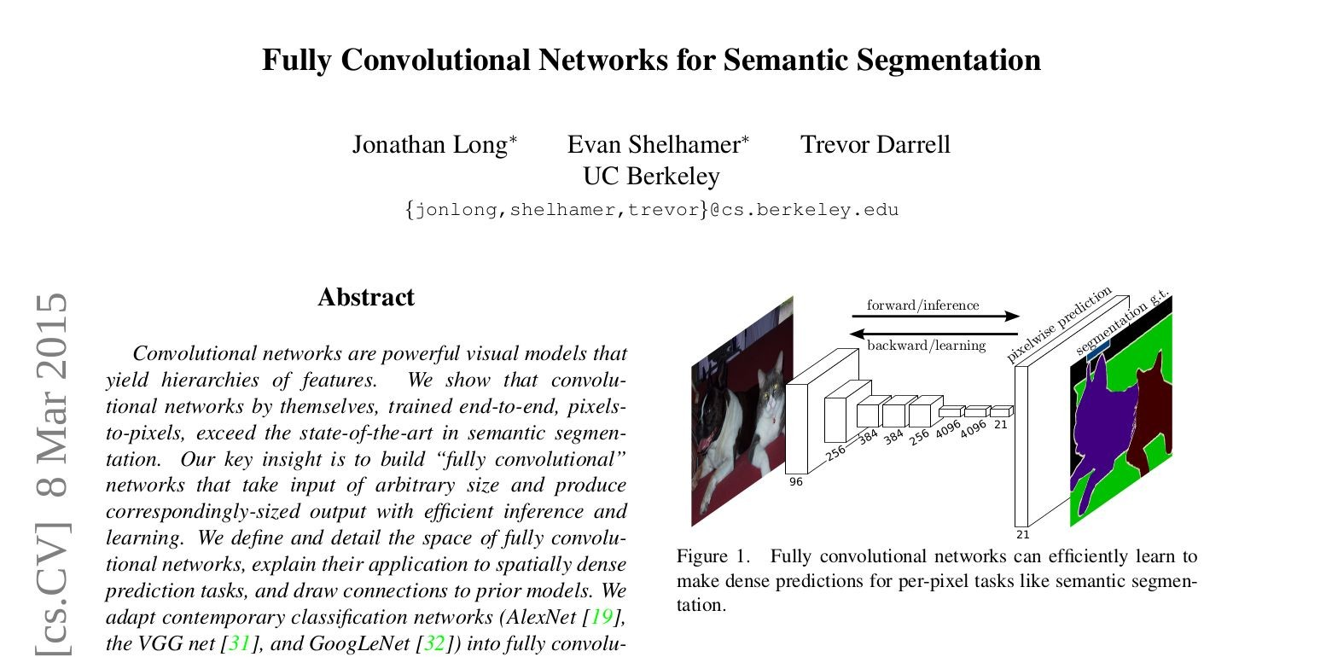
Fully Convolutional Network (FCN) Architecture
Key Takeaways:
Upsampling using Interpolation or Transpose Convolution
Transfer Learning

Slide 216
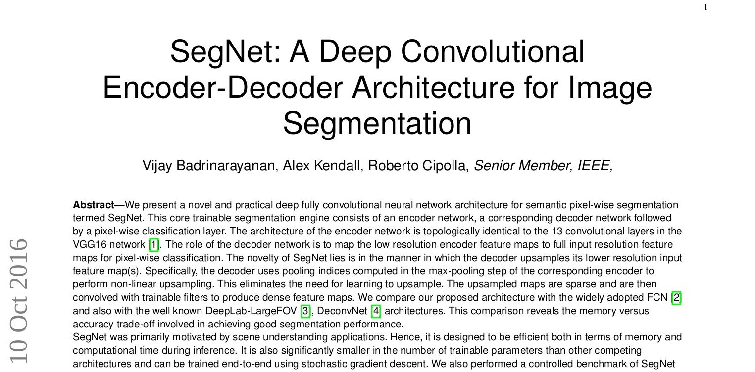
Segmentation Network (SegNet) Architecture
Key Takeaways:
Encoder Decoder Network
Upsampling using Max Unpooling
Transfer Learning

Slide 217
Steps for Image Segmentation using End-to-End model
Data Loading and Preprocessing
Load the Data
Define custom dataset and dataloader
Data Exploration
Image Segmentation through End to End Deep Learning model
Define model architecture
Train the model
Calculate IoU score

Slide 218
Thank you

Slide 219
Code Walkthrough of
End-to-End Deep Learning Approach

Slide 220
Understanding DL Architectures for Image Segmentation

Slide 221
What we will be covering in this module?
Introduction is Image Segmentation
How to solve Image Segmentation problems?
Approaches for Image Segmentation
Use Traditional Methods
Leverage Deep Learning
Understanding Deep Learning Architectures for Image Segmentation
Project on Lane Segmentation for Self Driving Cars
What’s Next?

Slide 222
Approach to solve Blood Cell Segmentation
Advanced Deep Learning

Slide 223
Understanding DL Architectures for Image Segmentation
U-Net Family
DeepLab Family
R-CNN Family

Slide 224
Key Takeaways of U-Net Family
Encoder-Decoder Network with skip connections

Slide 225
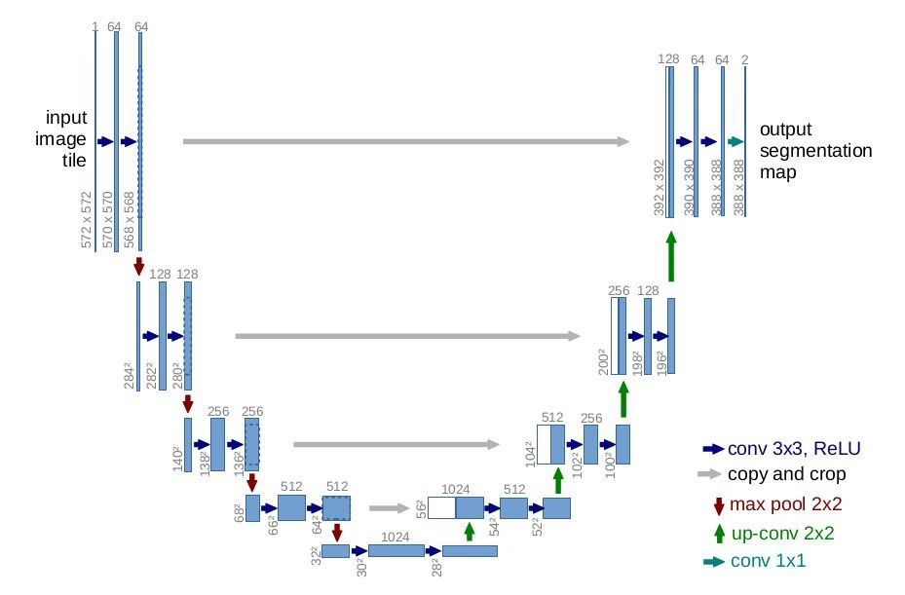
Key Takeaways of U-Net Family
Encoder-Decoder Network with skip connections

Slide 226
Key Takeaways of U-Net Family
Encoder-Decoder Network with skip connections

Slide 227
Key Takeaways of U-Net Family
Encoder-Decoder Network with skip connections
Source: Ronneberger O., Fischer P., Brox T. (2015) U-Net: Convolutional Networks for Biomedical Image Segmentation.

Slide 228
Key Takeaways of U-Net Family
Encoder-Decoder Network with skip connections
Has the capacity to learn from even very small data, hence is extremely useful in medical imaging or satellite imaging

Slide 229
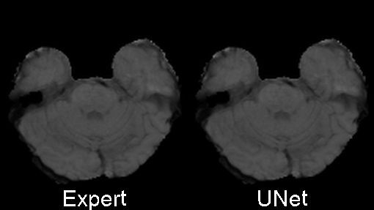
Key Takeaways of U-Net Family
Has the capacity to learn from even very small data, hence is extremely useful in medical imaging or satellite imaging
Source: https://github.com/ellisdg/3DUnetCNN

Slide 230
Key Takeaways of U-Net Family
Encoder-Decoder Network with skip connections
Has the capacity to learn from even very small data, hence is extremely useful in medical imaging or satellite imaging
Can be extended to a 3D version with just a few modiﬁcations

Slide 231
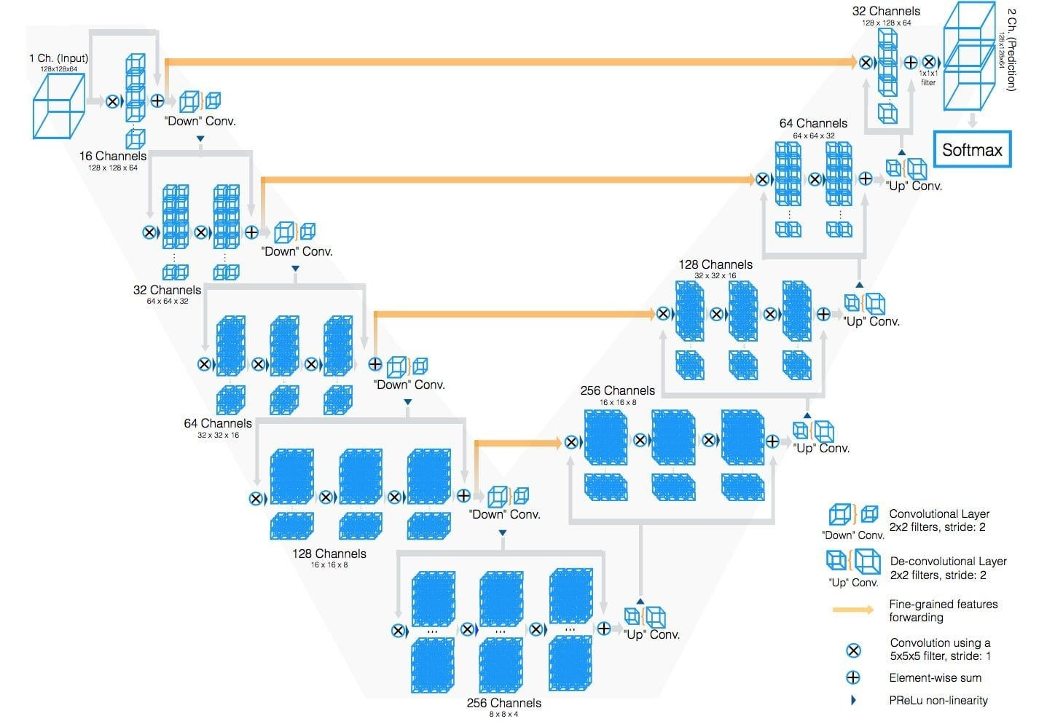
Key Takeaways of U-Net Family
Can be extended to a 3D version with just a few modiﬁcations
Source: Fausto Milletari et. al. (2016) V-Net: Fully Convolutional Neural Networks for Volumetric Medical Image Segmentation

Slide 232
Key Takeaways of U-Net Family
Encoder-Decoder Network with skip connections
Has the capacity to learn from even very small data, hence is extremely useful in medical imaging or satellite imaging
Can be extended to a 3D version with just a few modiﬁcations

Slide 233
Steps for Image Segmentation using U-Net model
Data Loading and Preprocessing
Load the Data
Deﬁne custom dataset and dataloader
Data Exploration
Image Segmentation through U-Net model
Deﬁne model architecture
Train the model
Calculate IoU score

Slide 234
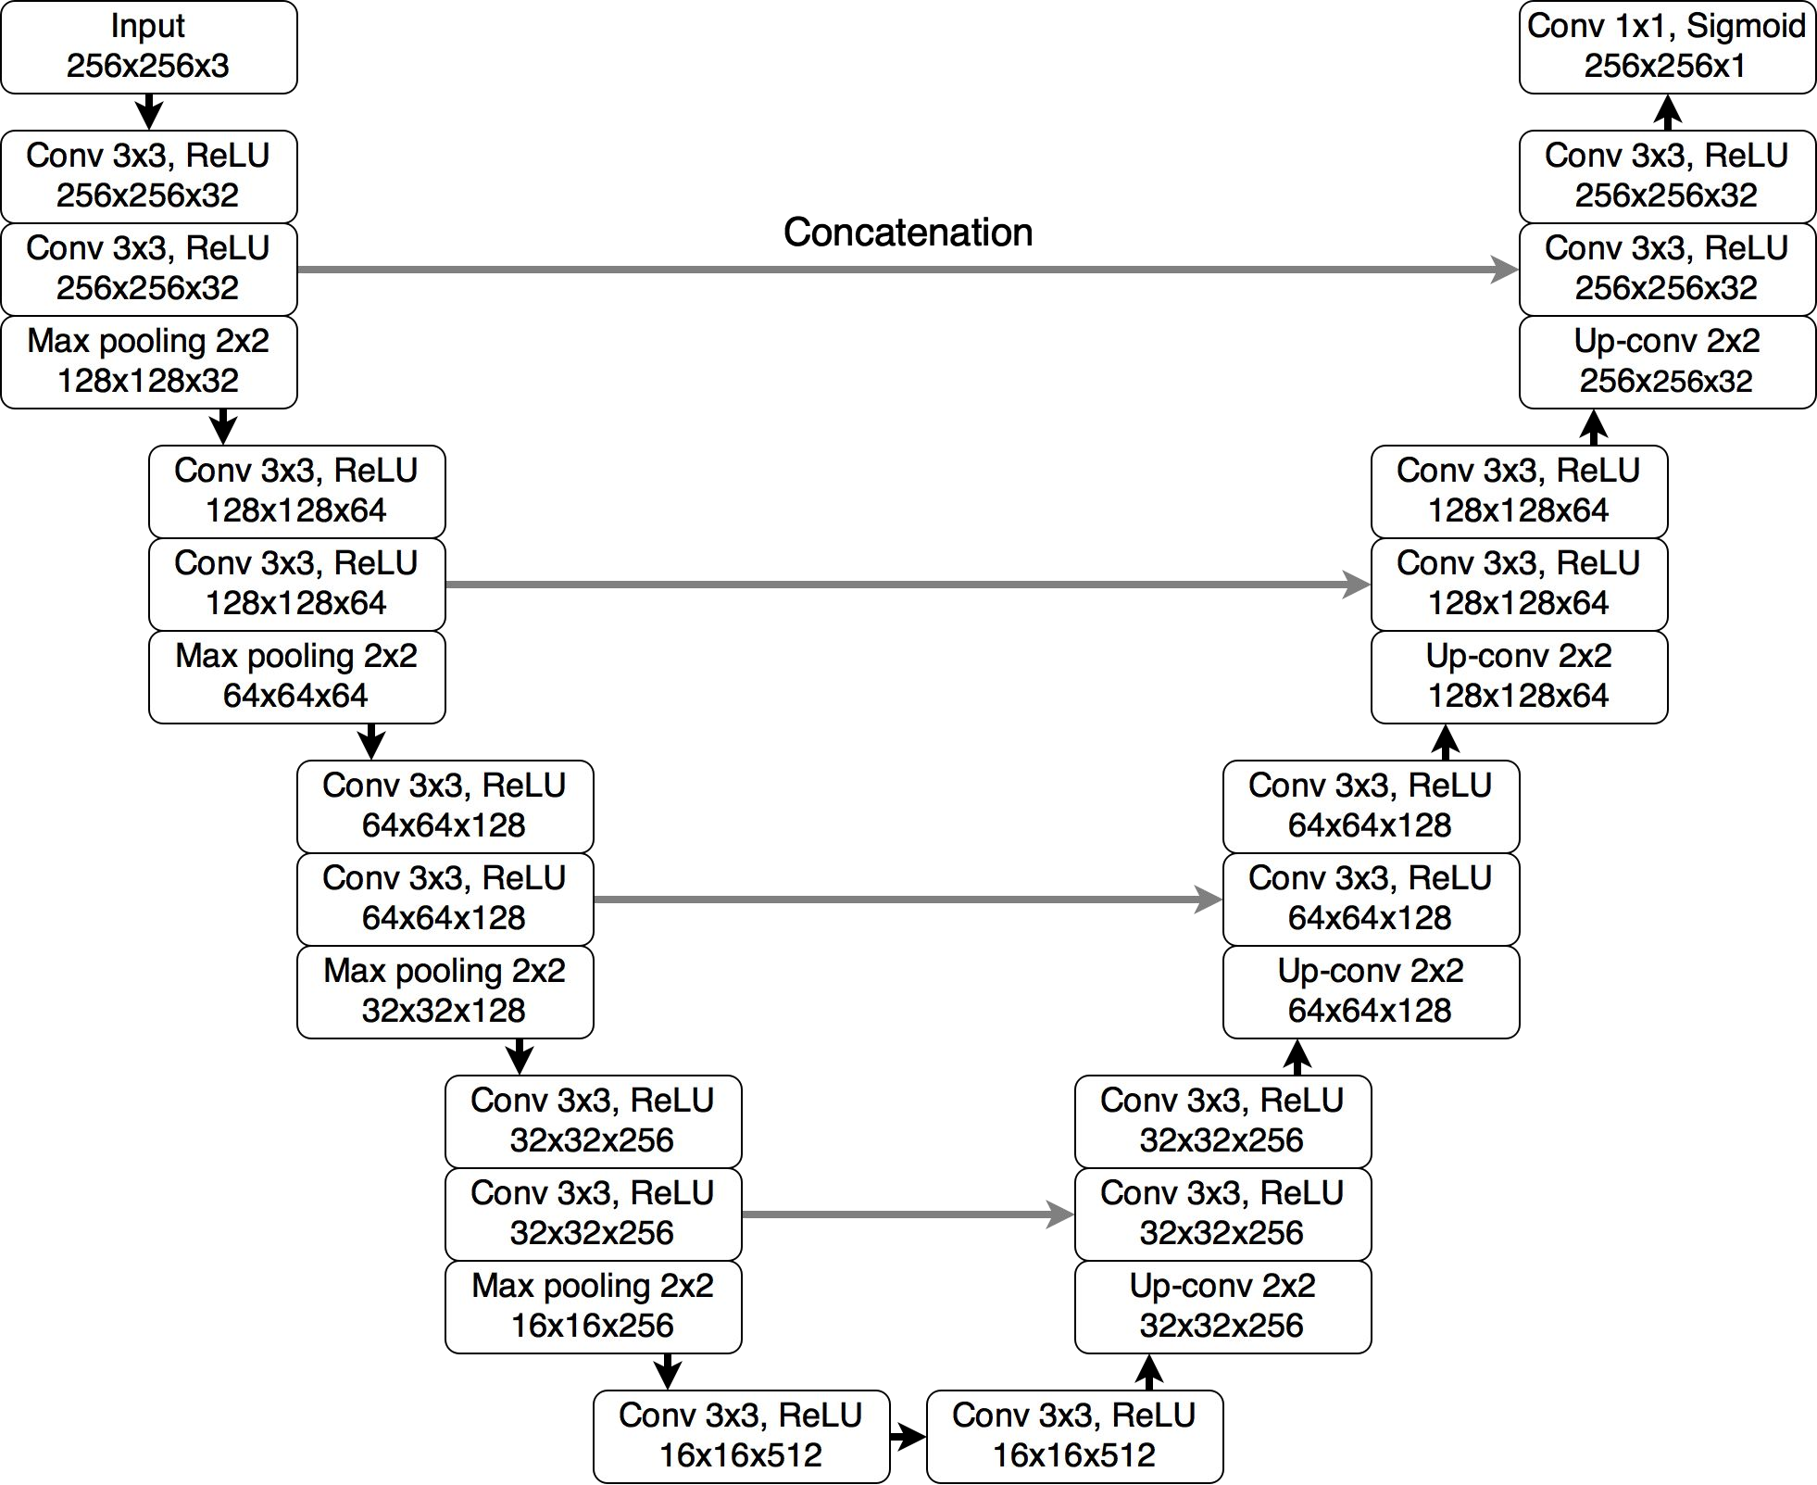
Steps for Image Segmentation using U-Net model
Source: Mateusz Buda et. al. (2019) "Association of genomic subtypes of lower-grade gliomas with shape features automatically extracted by a deep learning algorithm"

Slide 235
Code Walkthrough of U-Net

Slide 236
Thank you

Slide 237
Understanding DL Architectures for Image Segmentation

Slide 238
Approach to solve Blood Cell Segmentation
Advanced Deep Learning

Slide 239
Understanding DL Architectures for Image Segmentation
UNet Family
DeepLab Family
R-CNN Family

Slide 240
Key Takeaways of DeepLab Family
Encoder-Decoder Network with depthwise separable convolutions and point wise separable convolutions

Slide 241
Key Takeaways of DeepLab Family
Encoder-Decoder Network with depthwise separable convolutions
Input
CNN
CNN
Mask
Encoder
Decoder

Slide 242
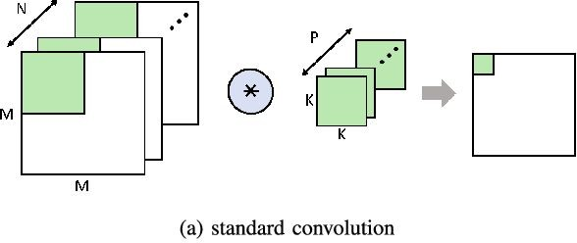
Key Takeaways of DeepLab Family
Encoder-Decoder Network with depthwise separable convolutions
Source: Lin Bai et. al. (2018) “A CNN Accelerator on FPGA Using Depthwise Separable Convolution”

Slide 243
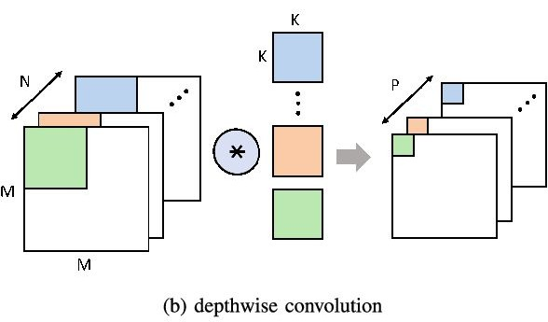
Key Takeaways of DeepLab Family
Encoder-Decoder Network with depthwise separable convolutions

Slide 244
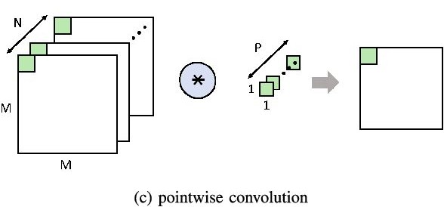
Key Takeaways of DeepLab Family
Encoder-Decoder Network with pointwise separable convolutions

Slide 245
Key Takeaways of DeepLab Family
Encoder-Decoder Network with pointwise separable convolutions
Spatial Pyramid Pooling Networks to capture multi-scale information

Slide 246
Key Takeaways of DeepLab Family
Spatial Pyramid Pooling Networks to capture multi-scale information

Slide 247
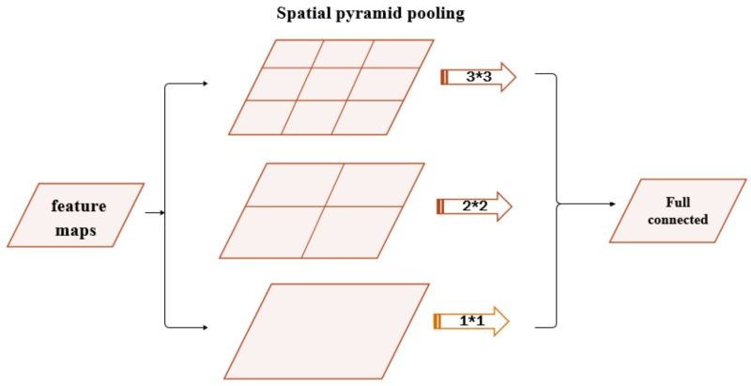
Key Takeaways of DeepLab Family
Spatial Pyramid Pooling Networks to capture multi-scale information

Slide 248
Key Takeaways of DeepLab Family
Encoder-Decoder Network with depthwise separable convolutions
Spatial Pyramid Pooling Networks to capture multi-scale information
Atrous Convolutions (or Dilated Convolutions) for larger effective ﬁeld of view and to reduce computational complexity

Slide 249

Key Takeaways of DeepLab Family
Atrous Convolutions (or Dilated Convolutions) for larger effective ﬁeld of view and to reduce computational complexity
Source - Francesco Visin et. al. (2016) A guide to convolution arithmetic for deep learning

Slide 250
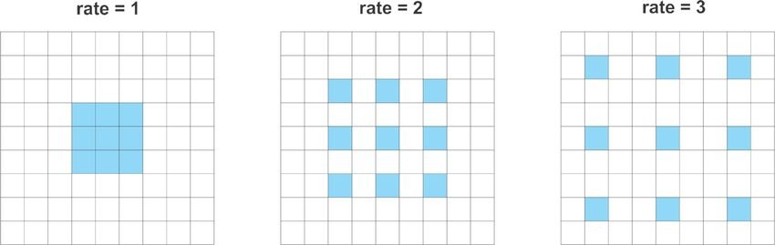
Key Takeaways of DeepLab Family
Atrous Convolutions (or Dilated Convolutions)

Slide 251
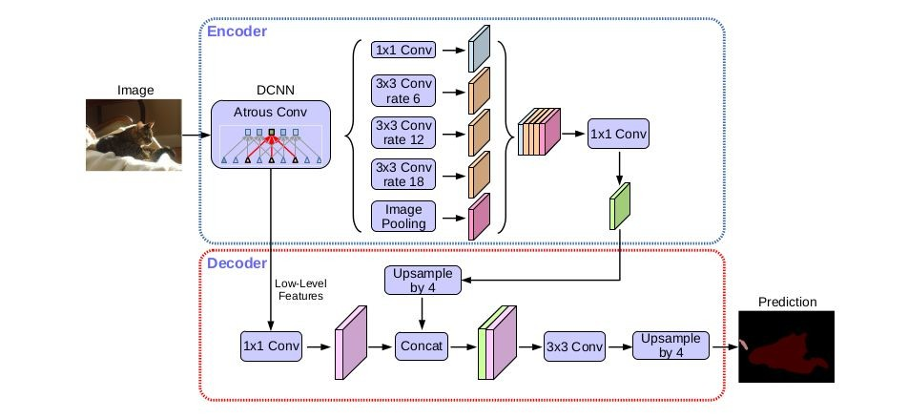
Key Takeaways of DeepLab Family
Overall DeepLabv3+ model
Source - Yukun Zhu et. al. (2018) Encoder-Decoder with Atrous Separable Convolution for Semantic Image Segmentation

Slide 252
Steps for Image Segmentation using DeepLabv3 model
Data Loading and Preprocessing
Load the Data
Deﬁne custom dataset and dataloader
Data Exploration
Image Segmentation through DeepLabv3 model
Deﬁne model architecture
Train the model
Calculate IoU score

Slide 253
Code Walkthrough of DeepLabv3

Slide 254
Thank you

Slide 255
Understanding DL Architectures for Image Segmentation

Slide 256
Approach to solve Blood Cell Segmentation
Advanced Deep Learning

Slide 257
Understanding DL Architectures for Image Segmentation
UNet Family
DeepLab Family
R-CNN Family

Slide 258
Key Contributions of R-CNN Family
Builds upon Faster R-CNN architecture, but we apply Segmentation mask along with Classiﬁcation and Box Regression

Slide 259
Recap: Faster R-CNN
Input Image
Feature Extraction using CNN
Region Proposal Network
Region of Interest
(RoI) Pooling
Classification
Regression
Fully Connected Layers
Object
Classiﬁcation
Object
Localization

Slide 260
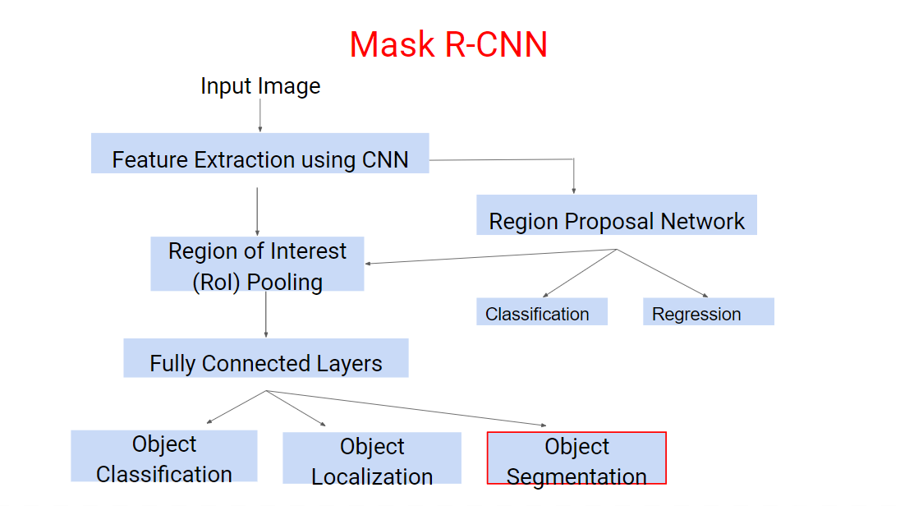

Slide 261
Key Contributions of R-CNN Family
Builds upon Faster R-CNN architecture, but we apply Segmentation mask along with Classiﬁcation and Box Regression
Multi-task training for Image Segmentation
Feature extraction using either pretrained models like Resnet or Feature Pyramid Networks

Slide 262
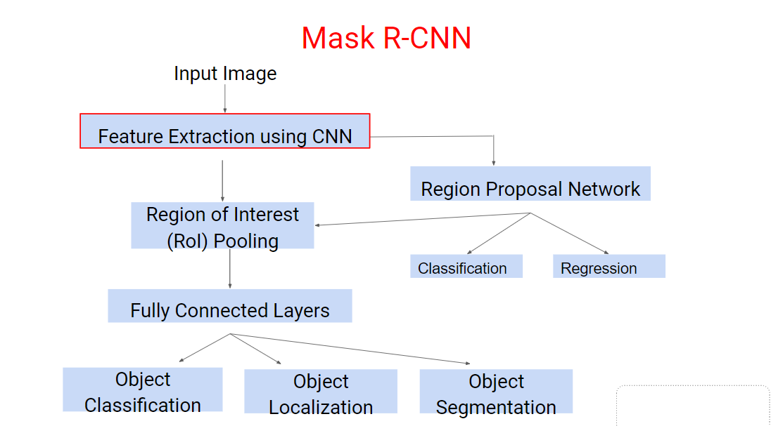

Slide 263
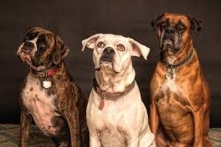
Key Contributions of R-CNN Family
Semantic Segmentation
Instance Segmentation

Slide 264
Steps for Image Segmentation using Mask R-CNN model
Data Loading and Preprocessing
Load the Data
Deﬁne custom dataset and dataloader
Data Exploration
Image Segmentation through Mask R-CNN model
Deﬁne model architecture
Train the model
Calculate IoU score

Slide 265
Code Walkthrough of Mask R-CNN

